Slide 1


CSE 201
Object Oriented Programming
ABSTRACTION

Slide 2
Table of contents
01
02
03
04
What is an Abstraction?
Implementing abstraction in Java
Abstract method
Advantages of Java Abstraction

Slide 3

Theory & design
What is abstraction?
Abstraction is a process of hiding the implementation details from the user and only the highlighted set of services provided to the user.
By using the abstraction concept, the back end code will be hidden from the user. As a result, users can't see or don't know anything about Backend code whether it is written in Java or other programming languages.
Backend code

Slide 4
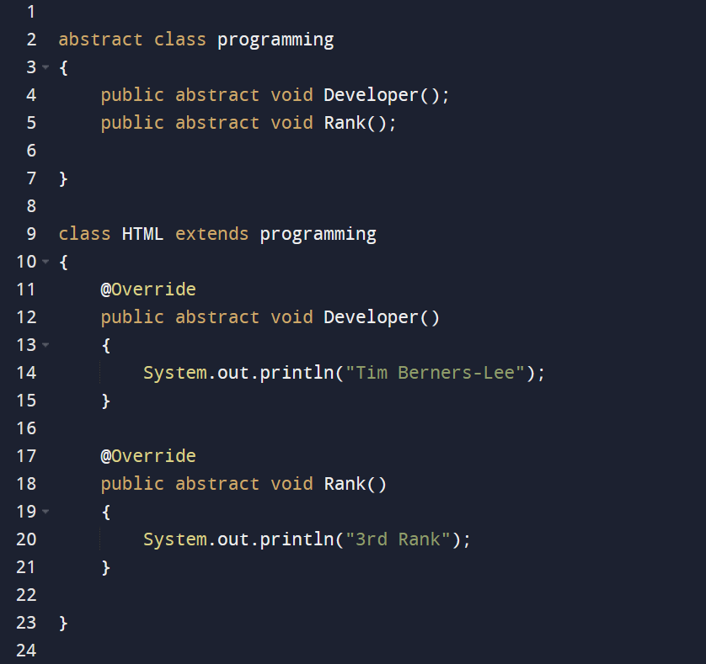
Implementing abstraction in Java
Abstract class
A class which contains the abstract keyword in its declaration is called abstract class.
- We can't create objects for abstract classes.
- It may or may not contain abstract methods.
- To use an abstract class, you have to inherit it from subclasses.
- If a class contains partial implementation then we should declare a class as abstract.

Slide 5
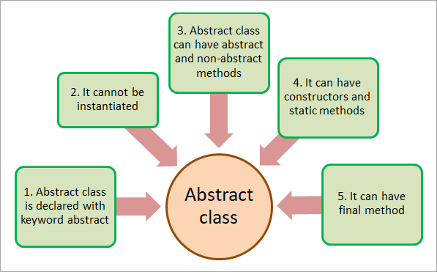
Implementing abstraction in Java
Abstract class

Slide 6
Implementing abstraction in Java
Abstract Method
A method which contain abstract modifier at the time of declaration is called abstract method.
- It can only be used in abstract class.
- It doesn't contain any body and always ends with.
- Abstract methods must be overridden in subclasses, otherwise it will also become an abstract class.
Whenever the action is common but implementation is different then we should use abstract method or
When we have incomplete information in the method, then we turn incomplete information into abstract method.

Slide 7
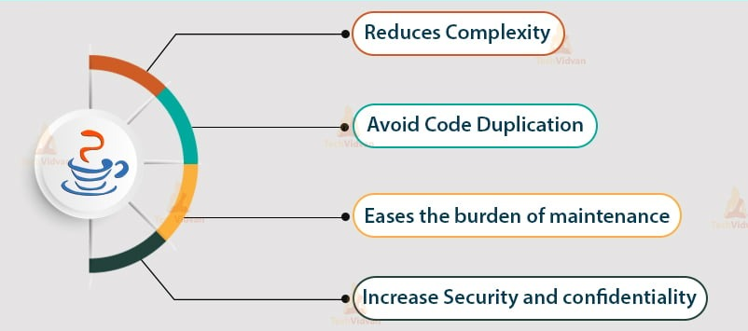
Theory & design
Advantages of JAVA Abstraction

Slide 8

Thanks!
Do you have any questions?
addyouremail@freepik.com
+91 620 421 838
yourwebsite.com

